Slide 1
Lecture 2: Discrete optimization. Local methods.

Slide 2
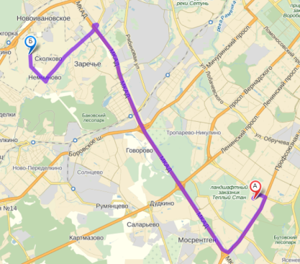
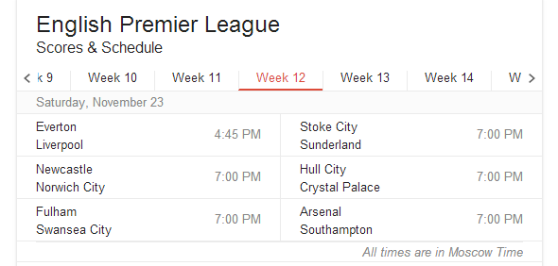
Overview of the discrete optimization
Many (the majority?) of problems have some discrete entities in them. E.g.:
Making choices
Assigning labels

Slide 3

Overview of the discrete optimization
Discrete optimization is hard
Unlike convex programming, global minima are often unattainable
Finding a good non-optimal solution quickly is non-trivial

Slide 4

Travelling salesman problem
Task: find the shortest tour
walking distance from house i to house j
0-1 decision (include into the tour or not)

Slide 5

Electronics assembly
Circuit
Feeders

Slide 6
Electronics assembly
Circuit
Feeders

Slide 7
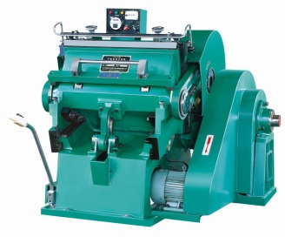
Scheduling (single machine)
Job1
Job2
Job3
Machine “visits” jobs
Switching between jobs takes various times
Seek for optimal schedule for repetitive manufacturing process
Job4
Job5
Job6

Slide 8
Minimum spanning tree
Task: find the shortest spanning tree
Initial interest: planning electrical networks

Slide 9
TSP: complexity
The problem is NP-complete
Polynomial algorithms are unknown/unlikely
For large instances, have to consider approximate algorithms

Slide 10
Heuristic 1: Greedy NN
Always connect two closest neighbors, which are not in the middle of the chain

Slide 11
Heuristic 1: Greedy NN
Always connect two closest neighbors, which are not in the middle of the chain

Slide 12
Heuristic 2: Greedy insertion
Grow the tour by inserting cheapest to include vertex

Slide 13
Heuristic 2: Greedy insertion
Grow the tour by inserting cheapest to include vertex

Slide 14
Heuristic 2: Greedy insertion
Grow the tour by inserting cheapest to include vertex

Slide 15
Heuristic 2: Greedy insertion
Grow the tour by inserting cheapest to include vertex

Slide 16
Kruskal’s algorithm for MST
Some non-trivial problems can be solved greedily.

Slide 17
Kruskal’s algorithm for MST
Some non-trivial problems can be solved greedily.
KRUSKAL(G):
1 A = ∅
2 foreach v ∈ G.V:
3 MAKE-SET(v)
4 foreach (u, v) ordered by weight(u, v), increasing:
5 if FIND-SET(u) ≠ FIND-SET(v):
6 A = A ∪ {(u, v)}
7 UNION(u, v)
8 return A
(pseudocode from Wikipedia)
Finds a globally optimal tree
With proper data structures, runs “almost” linearly in the number of edges.

Slide 18
Local Search
Random, null, greedy….
x = starting position;
while nIter++ < MAX_ITER
y = argmin( neighborhood(x) );
if f(y) < f(x)
x = y;
else \\no improvement found
break;
end while
Exhaustive search Random sampling

Slide 19
Heuristic: local search

Slide 20
Heuristic: local search

Slide 21
Local search and local optima
Definition: the neighborhood of X w.r.t. a local search algorithm A is the set of configurations within one step from X.
The run of the algorithm will end up in a local minimum (w.r.t. A).
Different local search algorithms have different neighborhoods and different sets of local minima.

Slide 22
2-Opt neighborhood for TSP

Slide 23
3-Opt neighborhood for TSP

Slide 24
Infeasible local search
Particularly useful for complex domains
λ might be changing (increasing) through the process

Slide 25

Greedy as infeasible local search
Greedy can be interpreted as an infeasible local search
D = Tour(V)
D’ = {Tour(V’)|V’ ⊂ V}

Slide 26
Greedy/local search
Often easy to implement
Often fast
Sometimes competitive
In most cases, only a local minimum is achievable (sometimes, bad ones)
In many cases, no optimality guarantees
Notes:
In practice, should always be considered and tried (unless obviously good non-local non-greedy algorithms exist)
Some algorithms are actually quite elegant
We will get back in the last lecture

Slide 27
Local Search with restart
x = starting position; best = x;
while nIter++ < MAX_ITER
for y in neighborhood(x)
if f(y) < f(x)
x = y;
if f(y) < f(best)
best = y
end for
if something (e.g. local minimum, M steps done)
x = random position;
end while
Exploitation
Exploration

Slide 28
Simulated Annealing
x = starting position, bestx = 0, bestf = +∞, T = T₀, γ=0.999;
while nIter++ < MAX_ITER
y = random in neighborhood(x)
dE = f(y) - f(x)
if exp(-dE/T ) > rand(0,1)
x = y;
if f(x) < bestf
bestx = x, bestf = f(x)
end
end
T = T*γ;
end while
temperature
exploration
exploitation

Slide 29
Simulated Annealing: high T
x = starting position, bestx = 0, bestf = +∞, T = T₀, γ=0.999;
while nIter++ < MAX_ITER
y = random in neighborhood(x)
dE = f(y) - f(x)
if exp(-dE/T ) > rand(0,1)
x = y;
if f(x) < bestf
bestx = x, bestf = f(x)
end
end
T = T*γ;
end while
close to 1
temperature
exploration
exploitation

Slide 30
Simulated Annealing: low T
x = starting position, bestx = 0, bestf = +∞, T = T₀, γ=0.999;
while nIter++ < MAX_ITER
y = random in neighborhood(x)
dE = f(y) - f(x)
if exp(-dE/T ) > rand(0,1)
x = y;
if f(x) < bestf
bestx = x, bestf = f(x)
end
end
T = T*γ;
end while
either large or close to zero
temperature
exploration
exploitation

Slide 31
Simulated Annealing
x = starting position, bestx = 0, bestf = +∞, T = T₀, γ=0.999;
while nIter++ < MAX_ITER
y = random in neighborhood(x)
dE = f(y) - f(x)
if exp(-dE/T ) > rand(0,1)
x = y;
if f(x) < bestf
bestx = x, bestf = f(x)
end
end
T = T*γ;
end while
Dennis Rapaport toolbox:
http://www.ph.biu.ac.il/~rapaport/java-apps/travel.html

Slide 32
Tabu search
x = starting position, bestx = 0, bestf = +∞
while nIter++ < MAX_ITER
y = argmin( neighborhood(x) \ TabuSet);
x = y;
if f(x) < bestf
bestx = x, bestf = f(x)
end
AddToTabuSet(x);
Expire(TabuSet);
end while
Max Nagl toolbox:
http://siebn.de/other/tabusearch/

Slide 33
Tabu set
Tabu set:
Just a list of points of a certain length
Set of sets of points (e.g. all tours containing the edge 4-3)
It is possible to tabu moves rather then configurations
We can allow tabu moves if they are improving the best solution we have seen

Slide 34
Block-coordinate descent
“hard”
“doable”
“doable”
Loop
if return; else
if return; else
End

Slide 35
k-means clustering
Task: split the points {x} into k clusters
Input points:
Cluster centers:
Point assignments:

Slide 36
Solving the k-means problem
- “hard” problem
Exact solution:
Exact solution:
(for each point pick the closest center)
(average points that belong to each cluster)

Slide 37
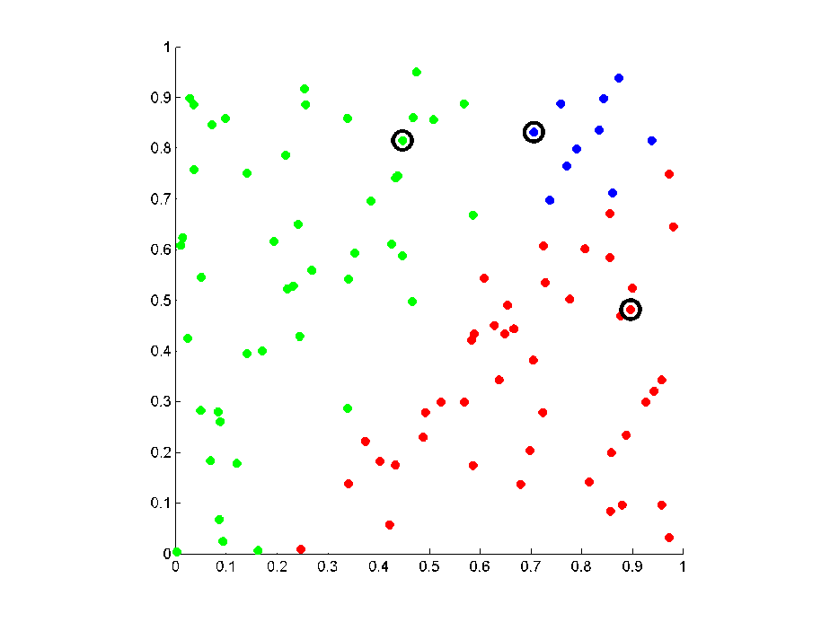
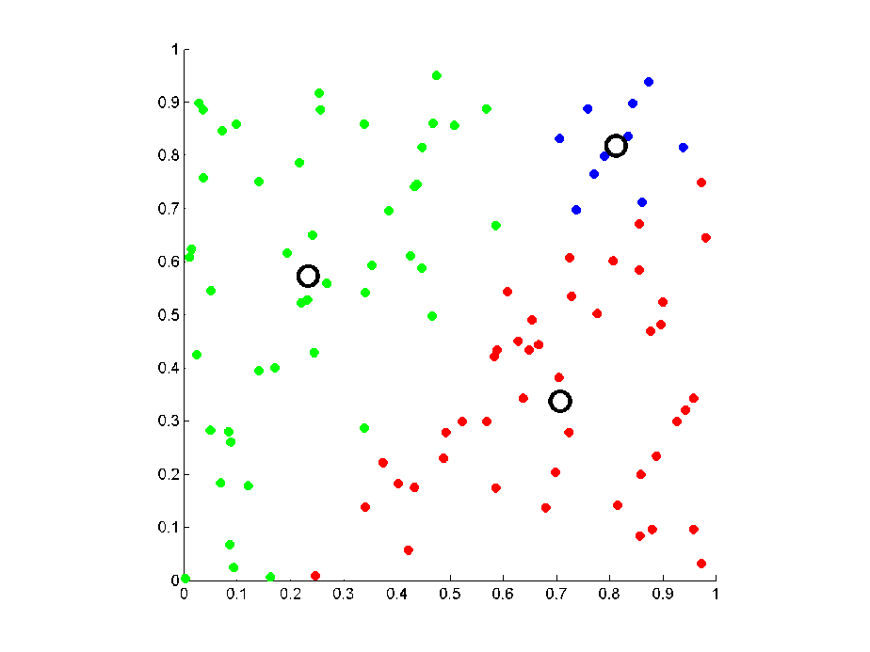
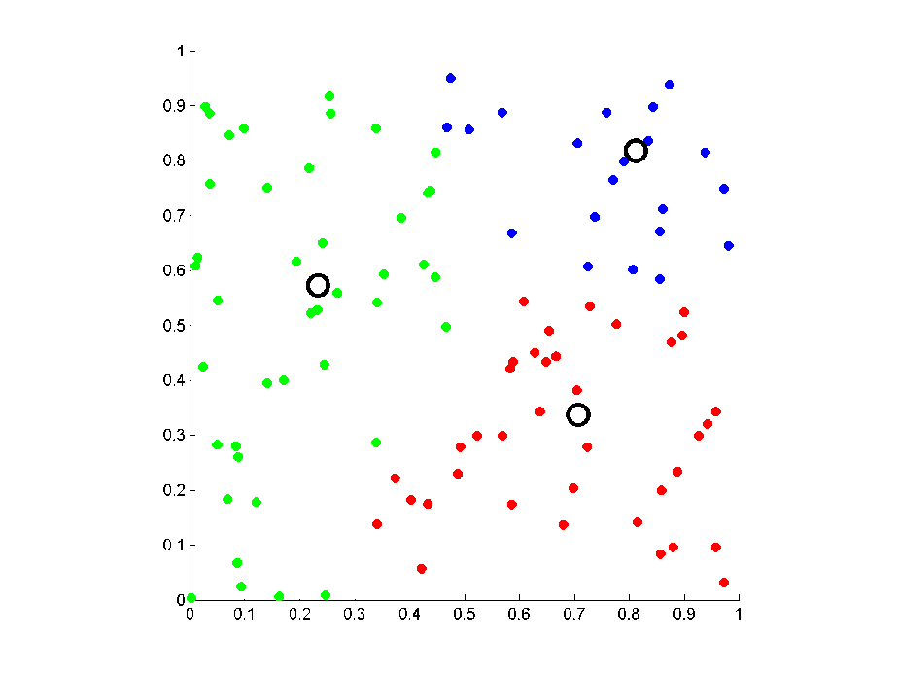
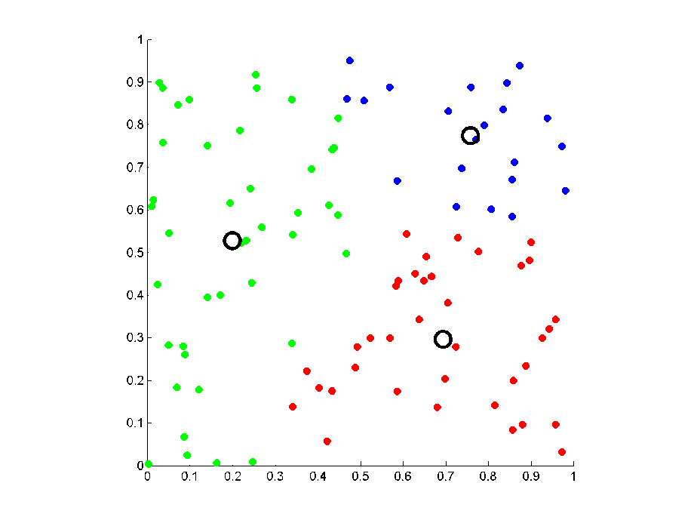
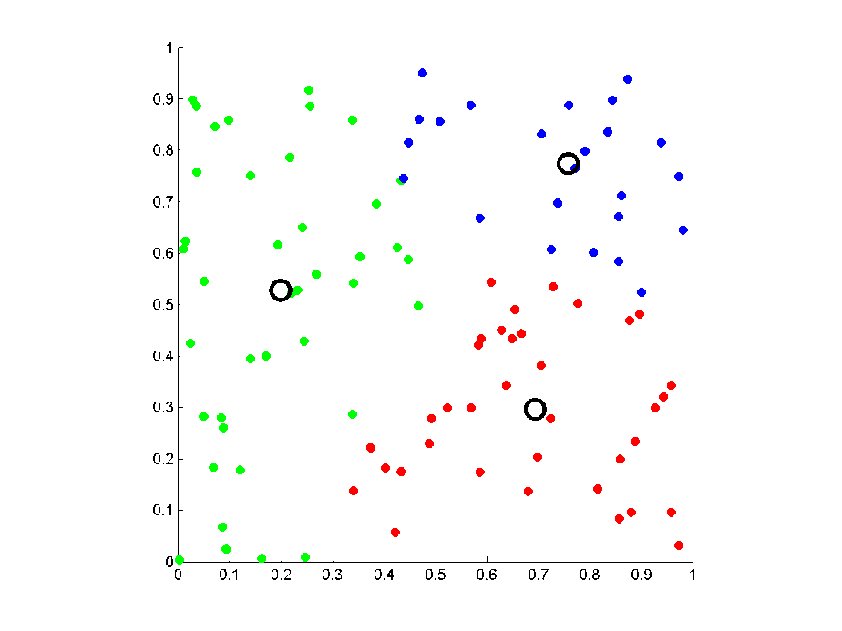

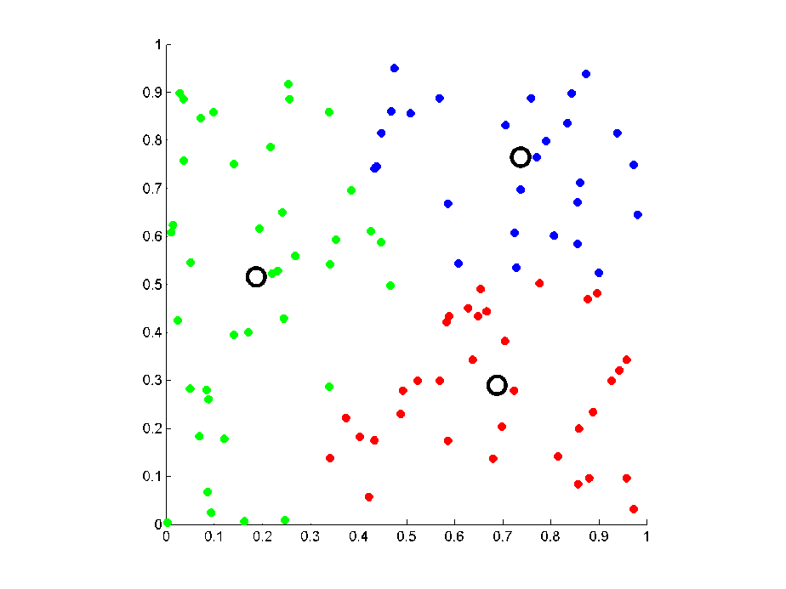
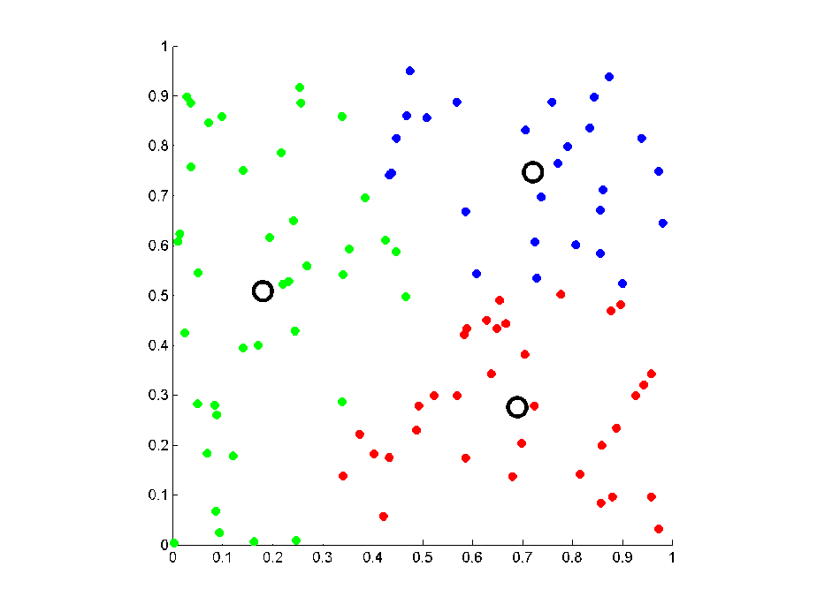
K-means example

Slide 38
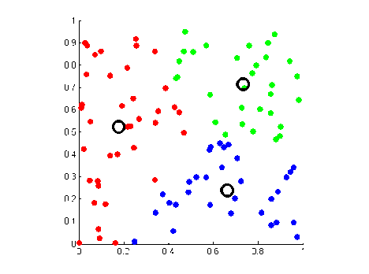
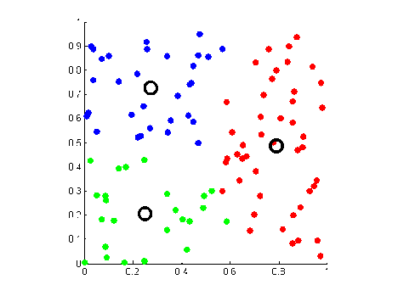
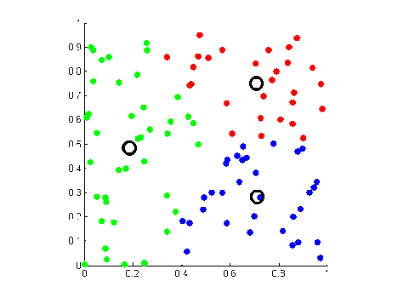
k-means clustering
Same input points
Three different local minima
Multiple restarts would help

Slide 39
Local optimization: summary
Greedy/local search is typically the first thing to try
Sometimes approximation guarantees are possible
In rare cases, optimum is obtained
Most complex systems with heterogeneous groups of variables are optimized using block-coordinate descent

